Slide 1

CozyHeaven - Hotel Booking Management System
Trainer : Mr.Javeed Mohammed
Trainee: Dhanashree R

Slide 2
Project Description
CozyHeaven - Hotel Booking Management System CozyHeaven is a full-stack hotel booking management web application built using Spring Boot (Java) for the backend and Angular for the frontend.
It contains 3 core modules:
-> Guest Dashboard
-> Owner Dashboard
-> Admin Dashboard

Slide 3
Module Description
👤 Guest Dashboard
-> Search hotels and rooms by location, check-in/check-out dates, and filters.
-> Book and cancel rooms.
-> Make secure payments.
-> View and edit personal profile.
👨‍ Owner Dashboard
-> Confirm or reject bookings.
-> Manage existing bookings.
-> Add and manage rooms for their hotels.
-> Update owner profile.
💼 Admin Dashboard
-> Add and manage hotels on the platform.
-> Manage user and owner accounts.
-> View overall system data.

Slide 4
Tech Stack
Frontend : Angular
Backend : Spring Boot (Java)
Database : MySQL
Auth : JWT tokens
Tools : VS Code, Eclipse STS ,Docker(for deployment of project),
Github ,Swagger and Postman (for backend testing)

Slide 5
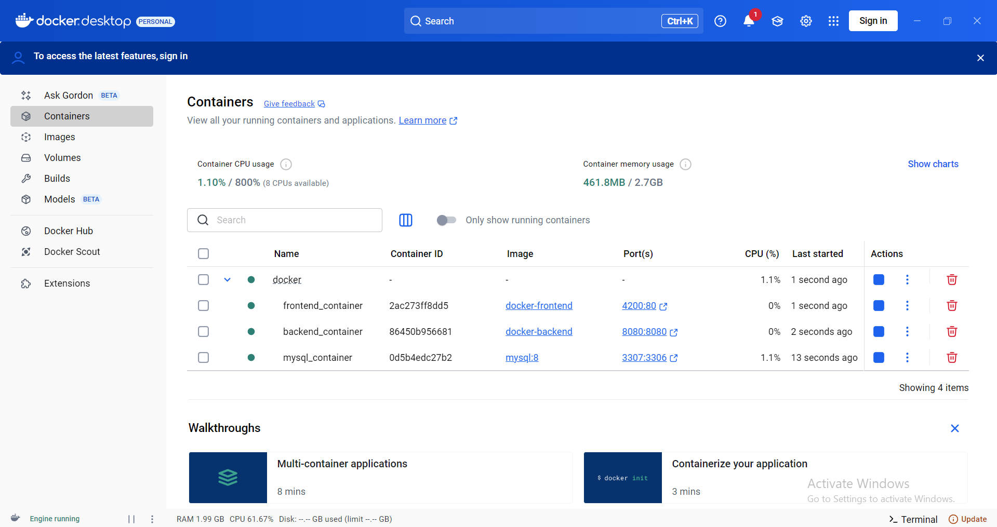
Deployed project in Docker

Slide 6
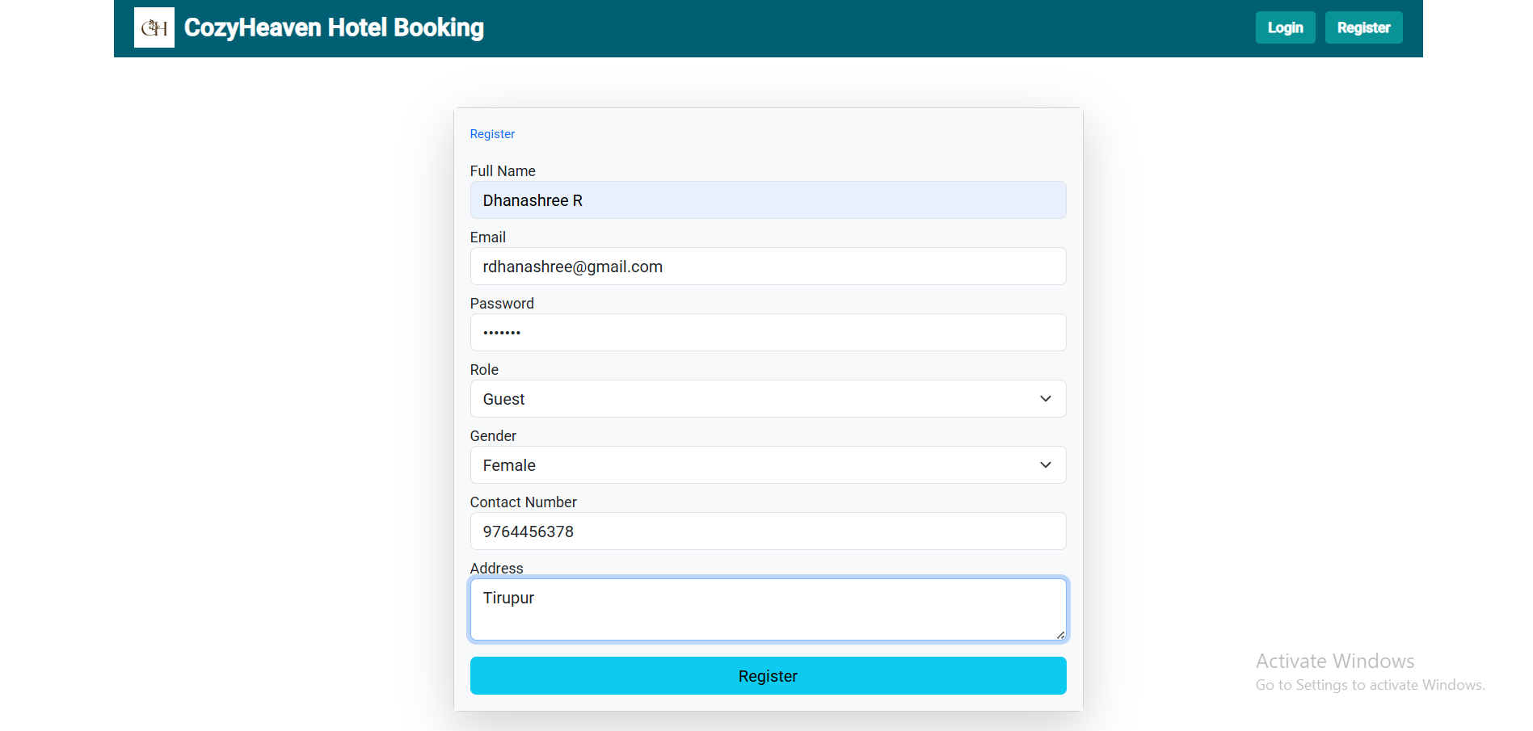
Registration Page

Slide 7
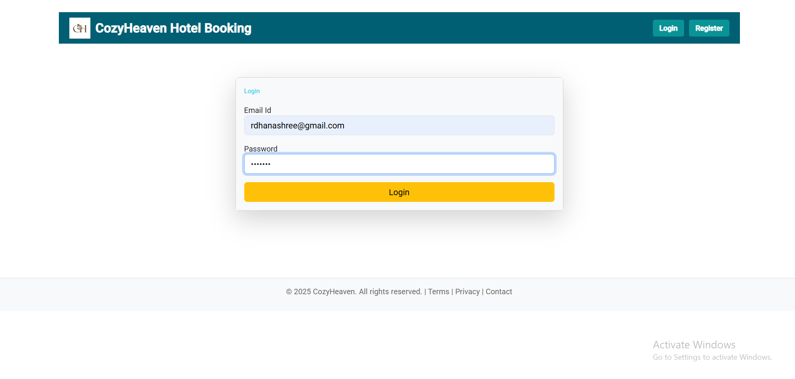
Login Page

Slide 8
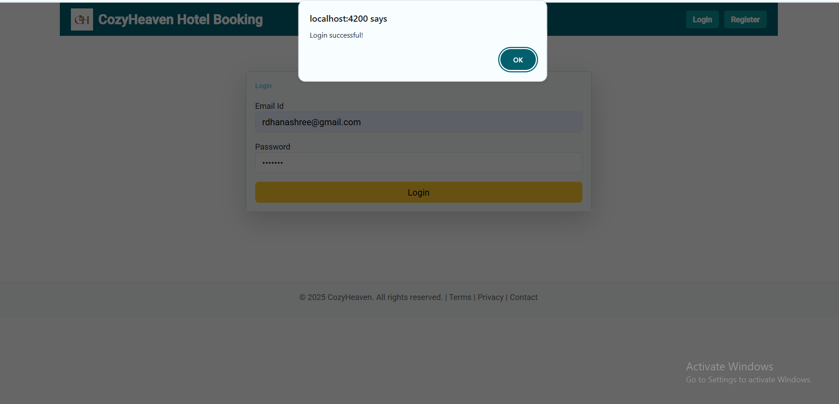
Login Page

Slide 9
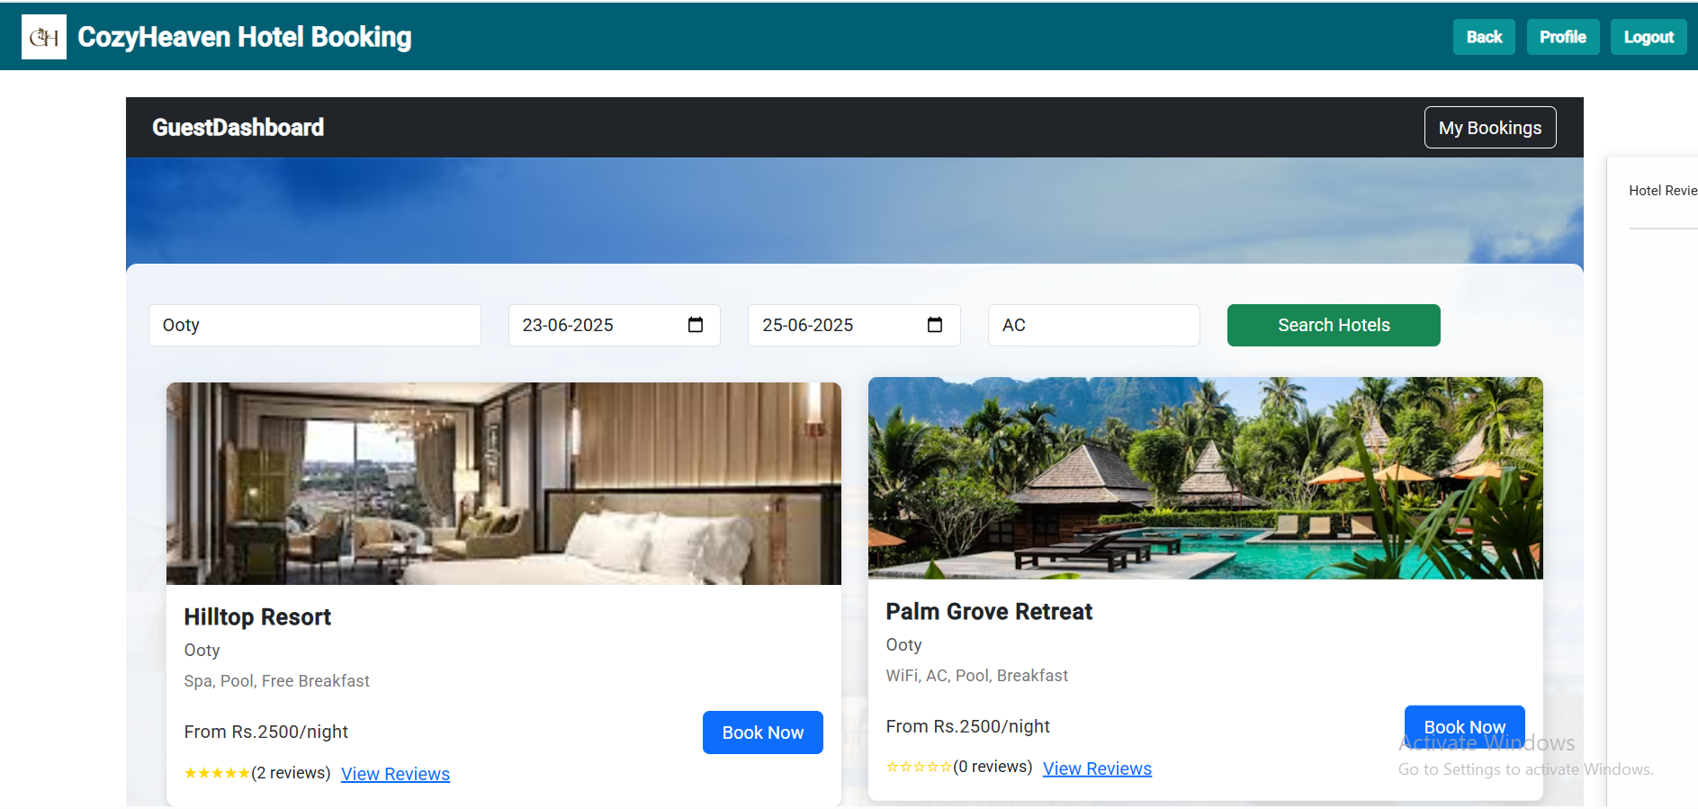
Guest-search hotels

Slide 10
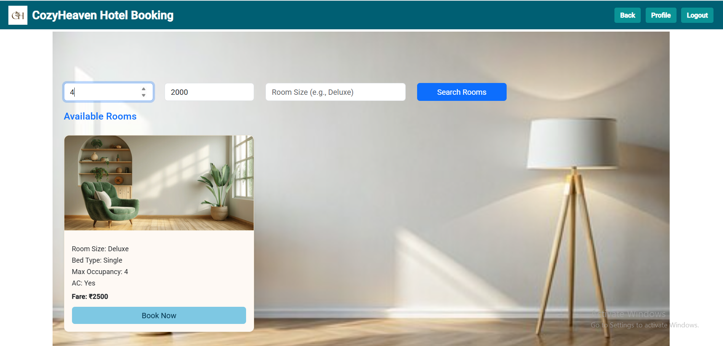
Guest - search rooms

Slide 11
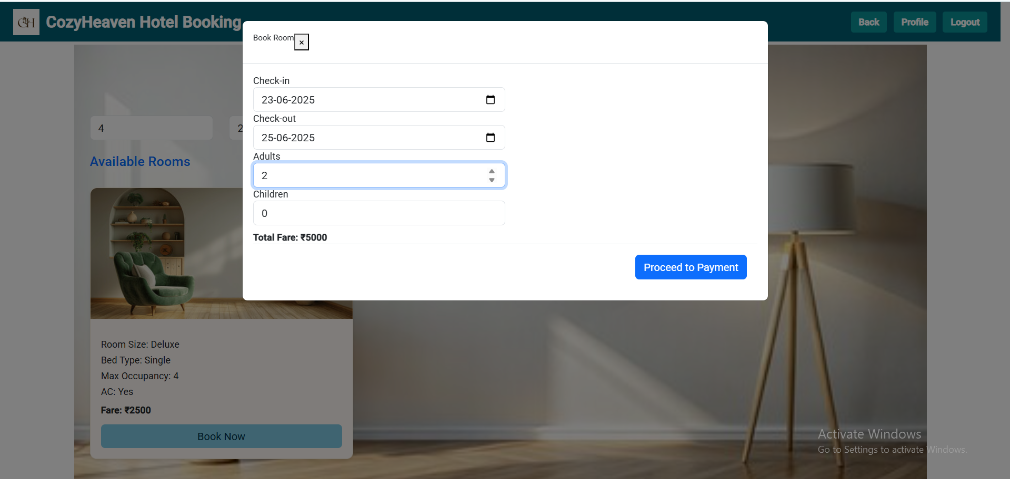
Guest - book room

Slide 12
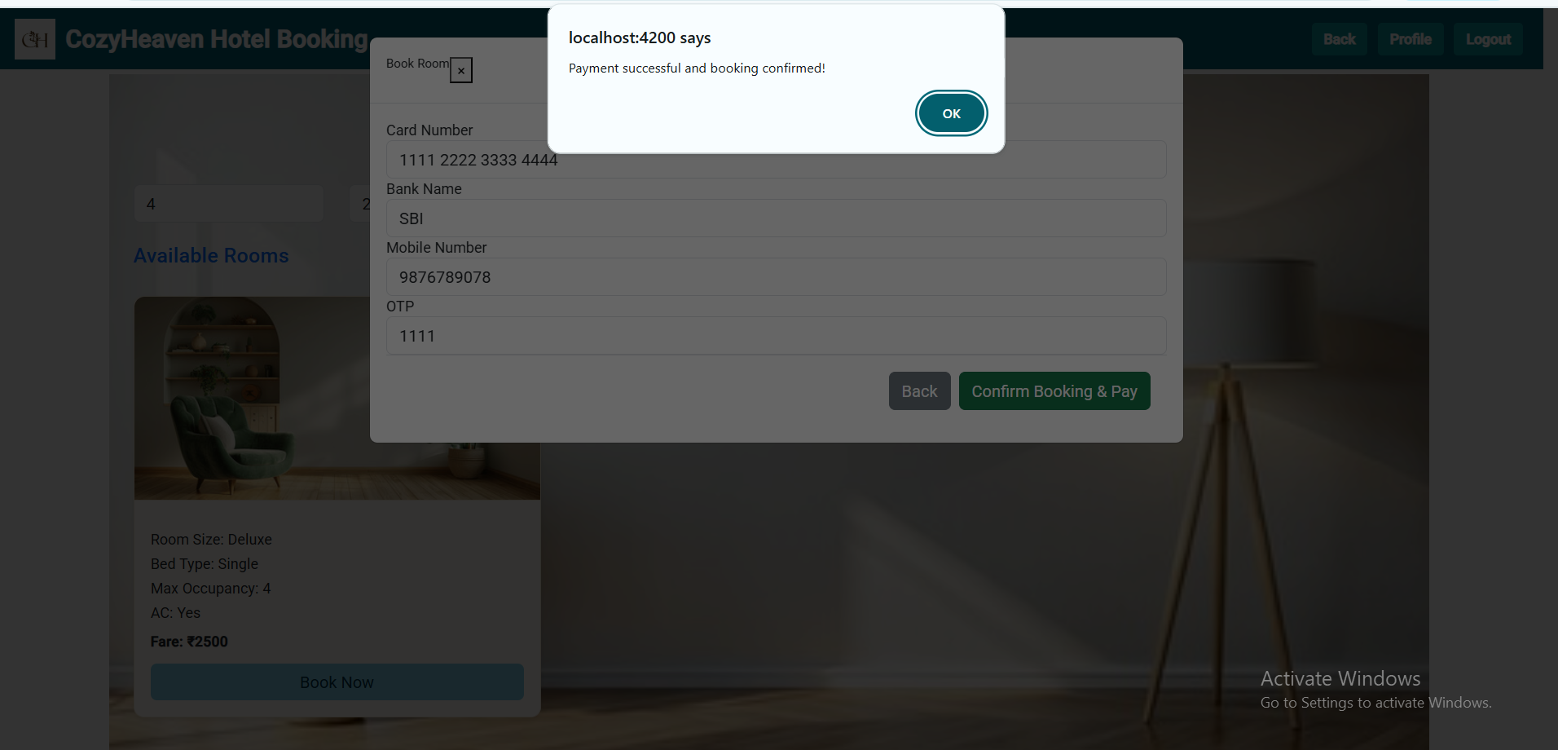
Guest - do payment

Slide 13
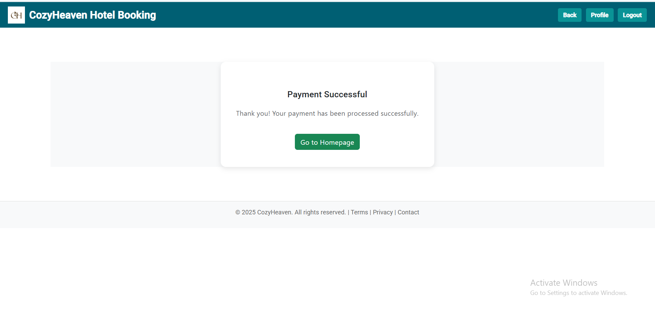
Guest - payment successful page

Slide 14
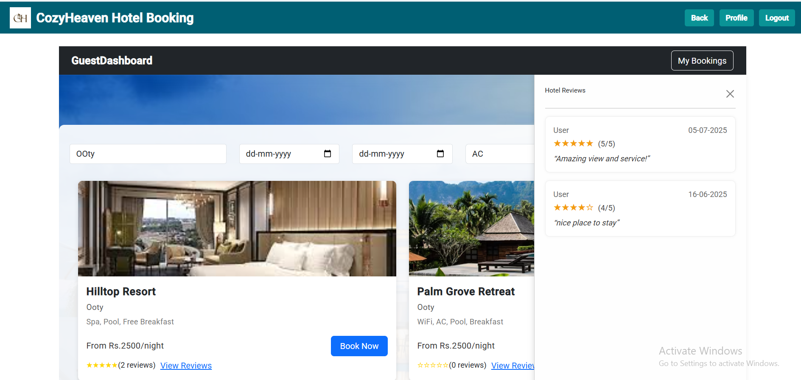
Guest - view other user reviews

Slide 15
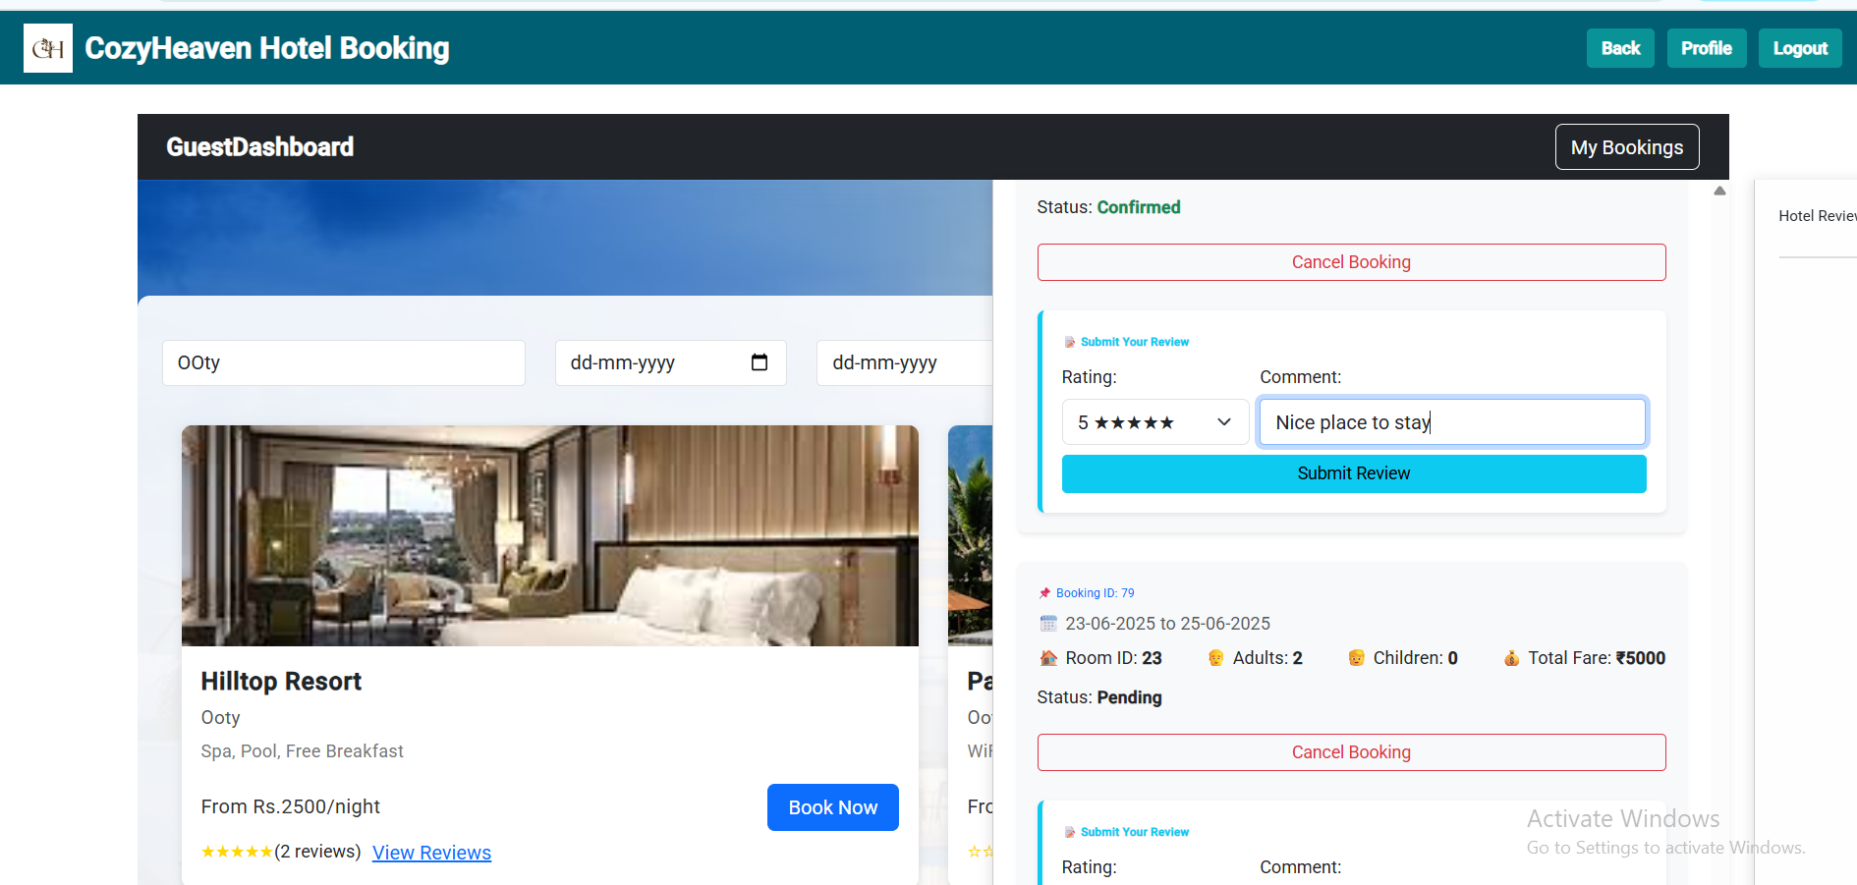
Guest - cancel booking and add reviews

Slide 16
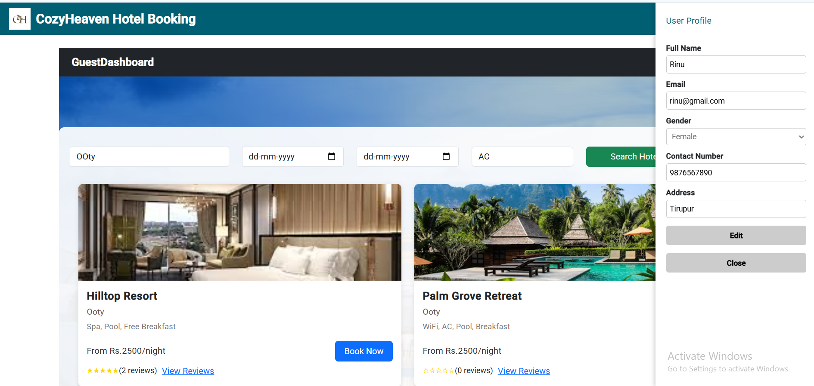
Guest - view and edit their profile

Slide 17
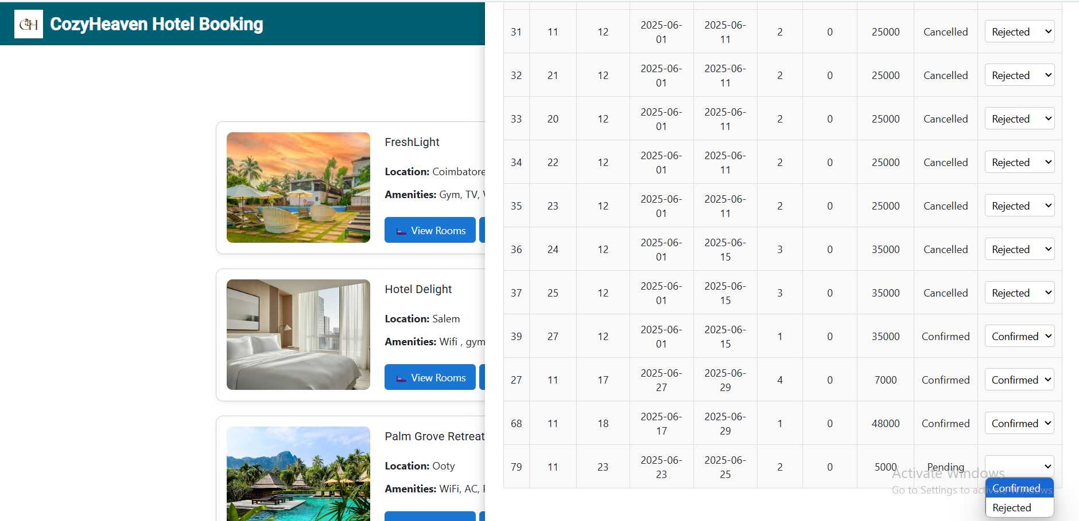
Owner - view their hotels and bookings made by the guest to their hotel

Slide 18
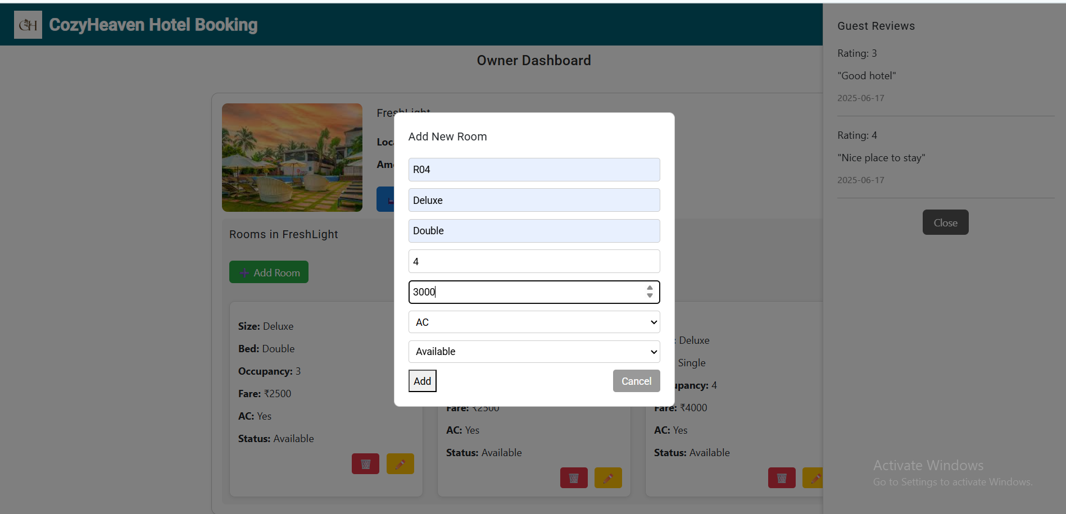
Owner - Add rooms and view reviews to their hotel

Slide 19
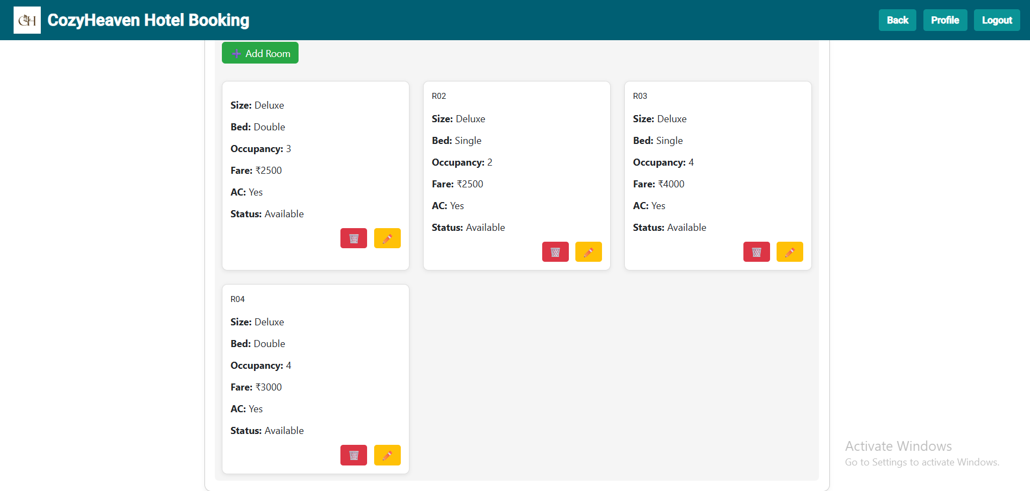
Owner - room added

Slide 20
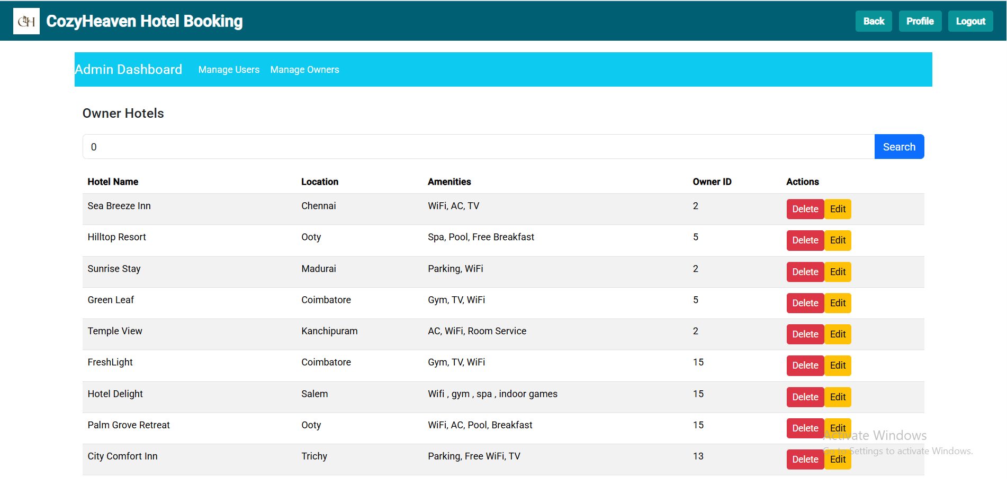
Admin - Lists hotels in the web app

Slide 21
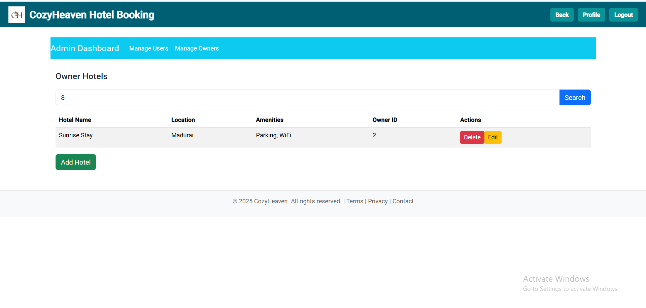
Admin - search hotel by id

Slide 22
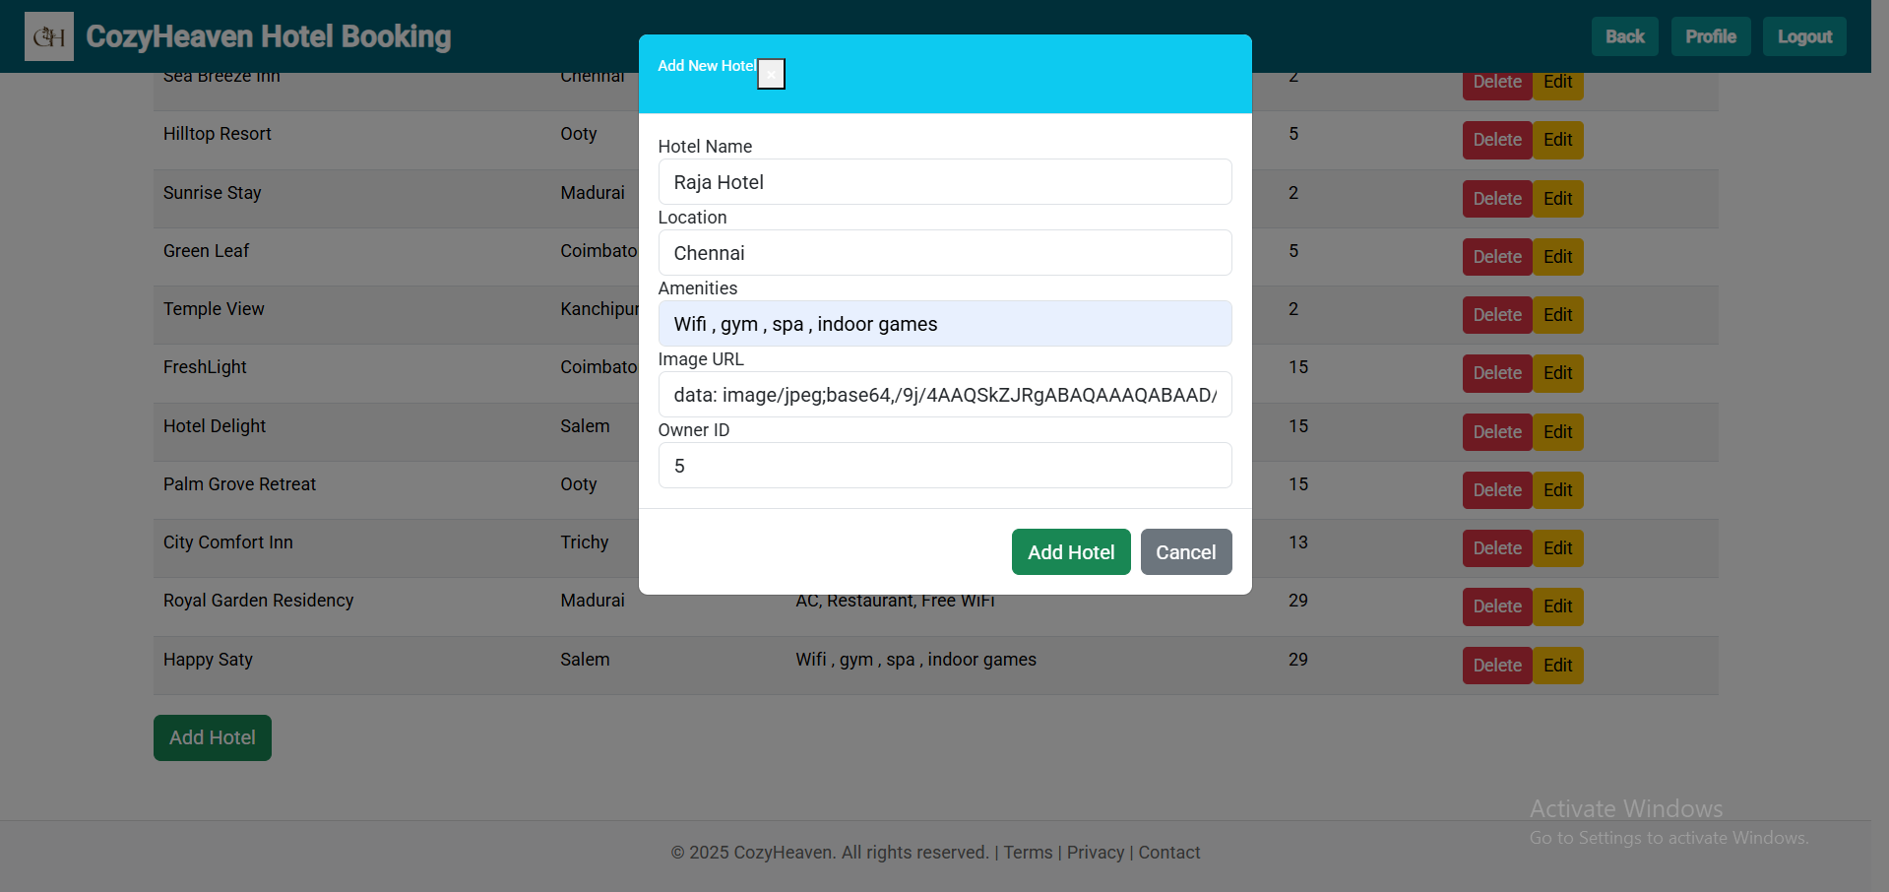
Guest - Add hotel

Slide 23
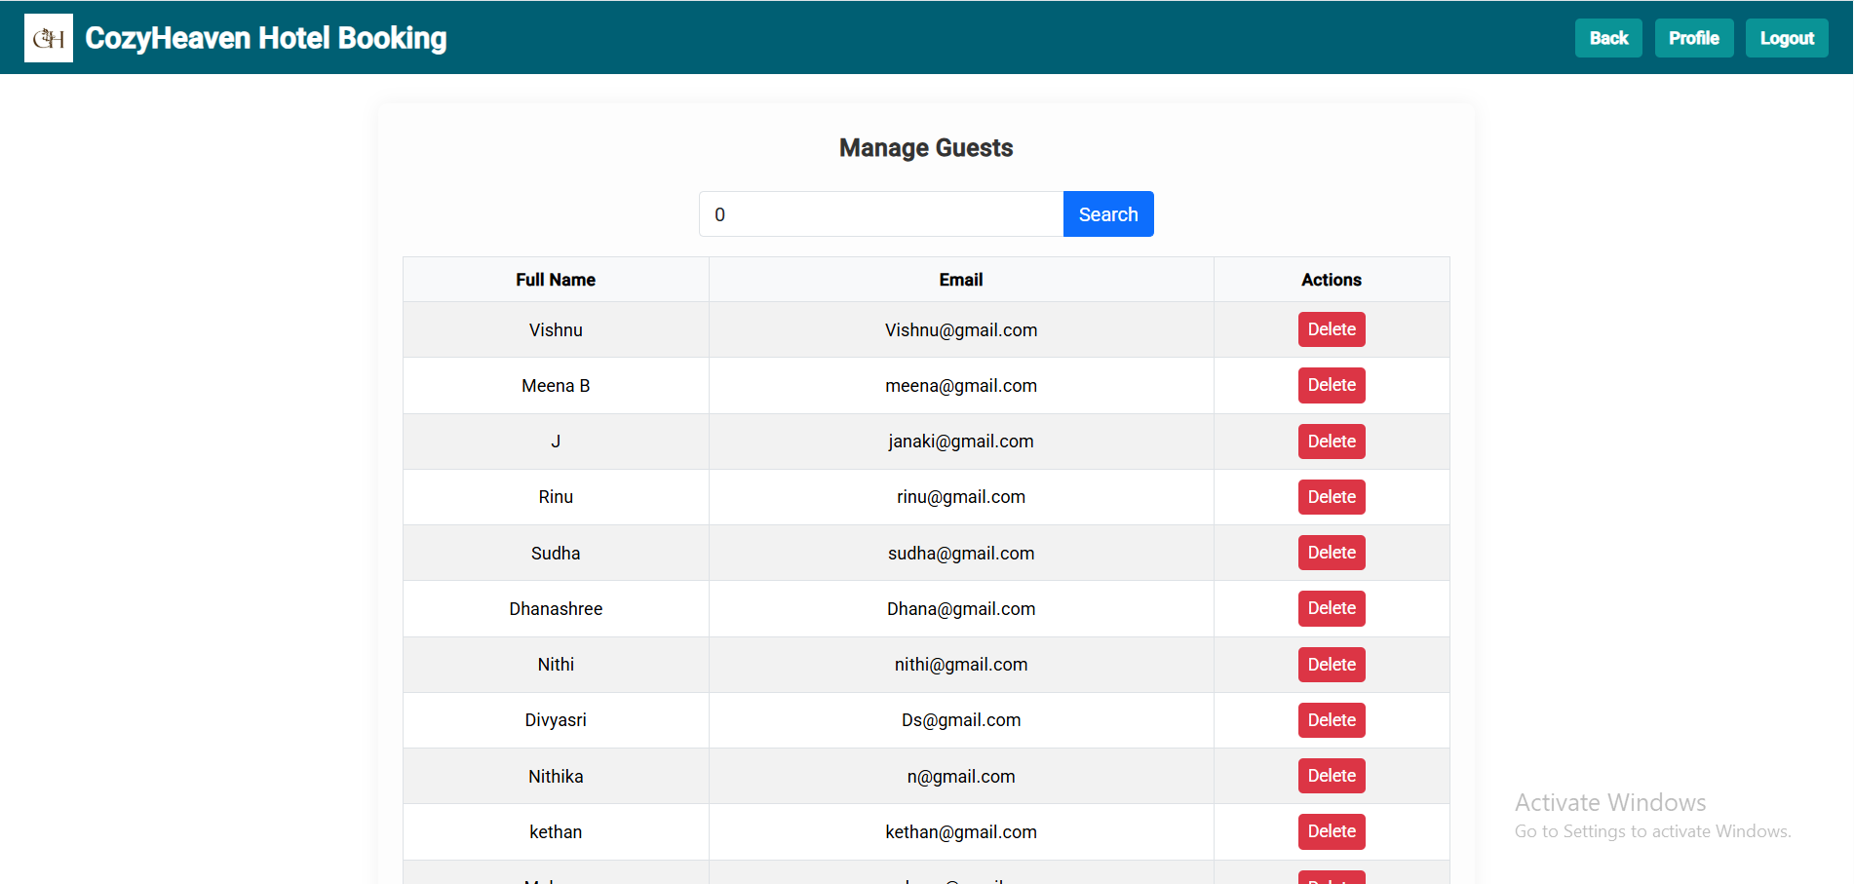
Admin - Manage guests

Slide 24
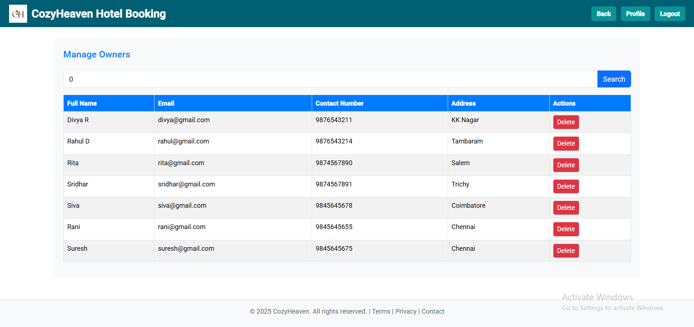
Admin - Manage owners and search filter is given

Slide 25
THANK YOU
Github link - https://github.com/Dhanashree2003/CaseStudy_CozyHeaven
Email Id - dhanashreer15@gmail.com
Presented by
Dhanashree R

